Slide 1

Liskov Substitution Principle
Eamonn de Leastar (edeleastar@wit.ie)
Dr. Siobhán Drohan (sdrohan@wit.ie)
Produced
by:
Department of Computing and Mathematics
http://www.wit.ie/

Slide 2
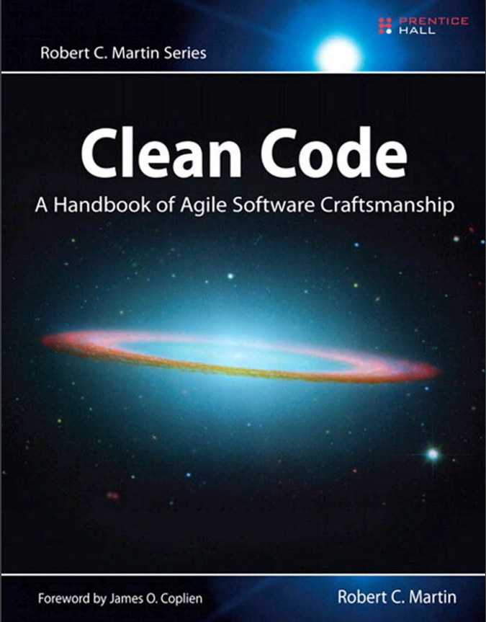
SOLID Class Design Principles
In this talk, we will refer to the SOLID
principles examples in this book and
also this website.
SOLID → five principles for object-oriented
class design i.e. best guidelines for
building a maintainable
object-oriented system.

Slide 3
SOLID Class Design Principles
S Single Responsibility Principle (SRP). Classes should have one, and only one, reason to change. Keep your classes small and single-purposed.
O Open-Closed Principle (OCP). Design classes to be open for extension but closed for modification; you should be able to extend a class without modifying it. Minimize the need to make changes to existing classes.
L Liskov Substitution Principle (LSP). Subtypes should be substitutable for their base types. From a client’s perspective, override methods shouldn’t break functionality.
I Interface Segregation Principle (ISP). Clients should not be forced to depend on methods they don’t use. Split a larger interface into a number of smaller interfaces.
D Dependency Inversion Principle (DIP). High-level modules should not depend on low-level modules; both should depend on abstractions. Abstractions should not depend on details; details should depend on abstractions.

Slide 4

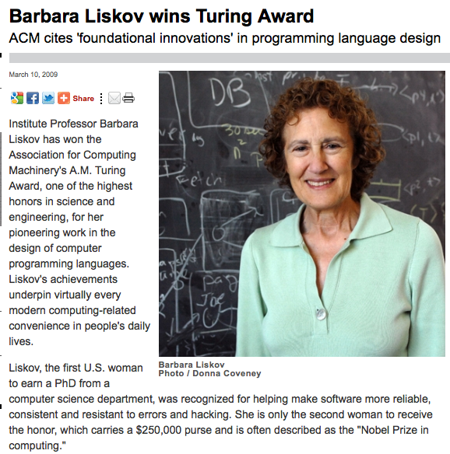
Barbara Liskov

Slide 5
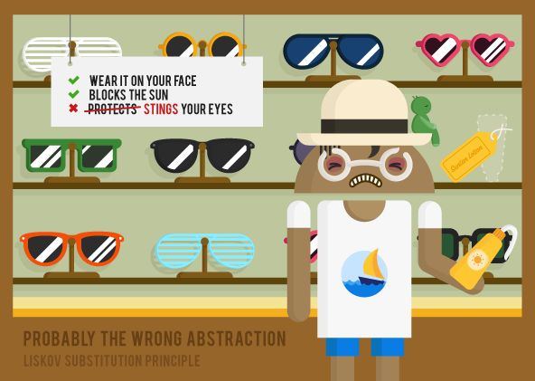
https://www.novoda.com/blog/designing-something-solid/

Slide 6
sunglasses interface would have fairly simple rules like:
shields from the sun;
attaches to a face.
Implementing the sunglasses interface with suntan lotion would seem to make sense:
it shields from the sun and attaches to the face.
https://www.novoda.com/blog/designing-something-solid/

Slide 7
sunglasses interface would have fairly simple rules like:
shields from the sun;
attaches to a face.
Implementing the sunglasses interface with suntan lotion would seem to make sense:
it shields from the sun and attaches to the face.
But semantically the expected behaviour is different enough to cause behavioural problems - in this case, by stinging your eyes!
https://www.novoda.com/blog/designing-something-solid/

Slide 8
“Don't implement interfaces in a way that breaks expected semantic behaviour.”
sunglasses interface would have fairly simple rules like:
shields from the sun;
attaches to a face.
Implementing the sunglasses interface with suntan lotion would seem to make sense:
it shields from the sun and attaches to the face.
But semantically the expected behaviour is different enough to cause behavioural problems - in this case, by stinging your eyes!
https://www.novoda.com/blog/designing-something-solid/

Slide 9
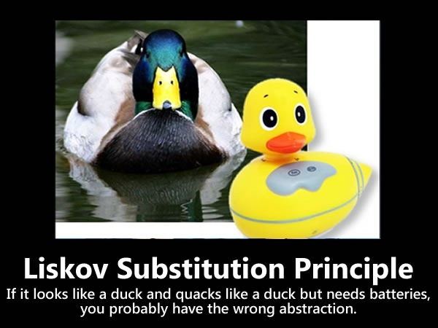
“Don't implement interfaces in a way that breaks expected semantic behaviour.”

Slide 10
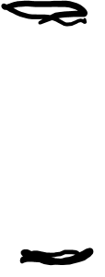
LSP – Formal Definition
Methods that refer to base classes must be able to use objects of derived types without knowing it.
If for each object o₁ of type S there is an object o₂ of type T such that for all programs P defined in terms of T, the behaviour of P is unchanged when o₁ is substituted for o₂ then S is a subtype of T.
Barbara Liskov, “Data Abstraction and Hierarchy,” SIGPLAN Notices, 23,5 (May, 1988).
T
O₂: T
extends
S
O₁: S

Slide 11
LSP: Simple Violation (and fix)

Slide 12
Simple Violation of LSP
references a base type Shape
violates LSP because it must know of every derived type of Shape.
void drawShape (Shape shape)
{
if (shape instanceof Square)
{
drawSquare ((Square)shape);
}
else if (shape instance of Circle)
{
drawCircle ((Circle) shape);
}
}
drawShapes must be modified whenever new derivatives of Shape are presented. What other SOLID principle does it violate?

Slide 13
Adhering to LSP
class Shape
{
void draw()
{//…}
}
void drawShape (Shape s)
{
s.draw();
}
class Circle extends Shape
{
private double itsRadius;
private Point itsCenter;
public void draw()
{ //… }
}
drawShape now adheres to LSP
class Square extends Shape
{
private double itsSide;
private Point itsTopLeft;
public void draw()
{ //… }
}

Slide 14
LSP: Semantic Violation

Slide 15
LSP
An object inheriting from
a base class, interface,
or other abstraction
must be semantically substitutable
for the original abstraction.
http://www.codemag.com/article/1001061

Slide 16
Rectangle
class Rectangle
{
private int width;
private int height;
public void setWidth (int width)
{...}
public void setHeight (int height)
{...}
public int getWidth ()
{...}
public int getHeight ()
{...}
}
Rectangle
Assume the Rectangle class is released for general use in the company.

Slide 17
Square
Introduce Square as a subclass of Rectangle.
Inheritance “is a” relationship:
A Square is a rectangle.
However, there is a subtle difference…it’s width and height are equal:
Square only needs one dimension but both are inherited.
Rectangle
Square

Slide 18
Square
For a Square, both setWidth() and setHeight() should not vary independently.
Client could easily call one and not the other – thus compromising the Square.
Rectangle
Square
class Rectangle
{
private int width;
private int height;
public void setWidth (int width)
{...}
public void setHeight (int height)
{...}
public int getWidth ()
{...}
public int getHeight ()
{...}
}

Slide 19
Square
Potential solution:
implement setWidth() and setHeight() in Square class.
Each of these methods should then make sure both width & height are adjusted.
Rectangle
Square
class Rectangle
{
private int width;
private int height;
public void setWidth (int width)
{...}
public void setHeight (int height)
{...}
public int getWidth ()
{...}
public int getHeight ()
{...}
}

Slide 20
Square
Potential solution implementation:
Rectangle
class Square extends Rectangle
{
public void setWidth (int width)
{
super.setWidth(width);
super.setHeight(width);
}
public void setHeight (int height)
{
super.setWidth(height);
super.setHeight(height);
}
}
Square

Slide 21
Polymorphism
void f (Rectangle r)
{
r.setWidth(5);
}
Rectangle
Polymorphism ensures, if the f() method:
is passed a Rectangle, then its width will be adjusted.
is passed a Square, then both height and width will be changed
Assume model is consistent & correct.
However….
Square

Slide 22
More Subtle Problem
void g (Rectangle r)
{
r.setWidth(5);
r.setHeight(4);
assert (r.getWidth() * r.getHeight()) == 20;
}
If r is a Rectangle instance…
g() methods works as expected
If r is a Square instance…
g() assertion fails
g() assumes that width and height of a Rectangle can be varied independently.
Substitution of a Square violates this semantic assumption.
Square violates LSP.

Slide 23
LSP: Semantic Violation
Square
!=
Rectangle

Slide 24
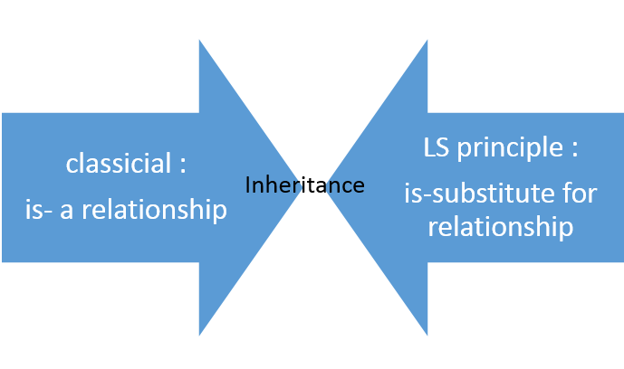
LSP: Subtypes should be substitutable for their base types.

Slide 25
Validating the Model
A model, viewed in isolation, cannot be meaningfully validated.
The validity of a model can only be expressed in terms of its clients:
Examining the final version of the Square and Rectangle classes in isolation, we found that they were self consistent and valid.
When we examined from the viewpoint of g() (which made reasonable assumptions) the model broke down.
Rectangle
Square

Slide 26
Validating the Model
When considering whether a design is appropriate or not, it must be examined in terms of the reasonable assumptions that will be made by the users of that design.
Rectangle
Square

Slide 27
Behavioural Problems
A square might be a rectangle, but a Square object is not a Rectangle object.
the behaviour of a Square object is not consistent with the behaviour of a Rectangle object.
The LSP makes clear that the inheritance relationship pertains to behaviour that clients depend upon.
Square
!=
Rectangle

Slide 28
With LSP…
“is-a” really means
“behaves exactly like”

